Slide 1

Flight and Passenger Management System: A Comprehensive Technical Analysis
A Three-Tier Architecture Implementation for Airline Booking Operations
Version 1.0.0 | January 9, 2026

Slide 2
Project Overview & Requirements
This prototype simulates a complete flight booking ecosystem implementing core airline operations including flight search, booking management, payment processing, check-in procedures, and customer support using a three-tier architecture.
Functional Requirements
Real-time flight search and availability checking
End-to-end booking workflow with PNR generation
Mock payment gateway integration with card validation
Digital check-in with passport verification
Booking cancellation and refund processing
Customer support ticket creation and tracking
Non-Functional Requirements
Performance
Scalability
API response time < 200ms for search operations
Stateless backend design for horizontal scaling
Usability
Reliability
Intuitive SPA interface with responsive design
Consistent data state across booking lifecycle
Security
Maintainability
Input validation, identity verification, passport-based authentication
Clean code structure with separation of concerns
Technology Stack
Node.js, Express.js, JavaScript, HTML5, CSS3

Slide 3
System Architecture: Three-Tier Design
The system employs a Three-Tier Architecture for clear separation of concerns and scalability, structured as follows:
Presentation Layer
HTML/CSS/JavaScript SPA, client-side state management.
Application Layer
Express.js, Controllers, Business Logic.
Data Layer
In-Memory Arrays for mock database storage.

Slide 4
Design & Implementation Architecture
System Architecture: Three-Tier Design
1
2
3
Presentation Layer
Application Layer
Data Layer
HTML/CSS/JavaScript SPA
Express.js server
In-memory arrays
Vanilla JavaScript (ES6+), async/await, Fetch API
Controllers, business logic, service simulation
flights[], bookings[], supportTickets[]
Key Data Models
Flight Model
Booking Model
Support Ticket Model
flightId
bookingId
ticketId
origin
pnr
pnr
destination
flightId
issueType
date
passenger
details
time
status
status
price
totalPrice
seats
ticketIssued
checkedIn
Design Choices & Rationale
Three-Tier MVC
RESTful API
Vanilla JavaScript
Separation of concerns, independent scaling, testability
Standard HTTP methods, resource-oriented URLs, stateless design
No framework overhead, educational value, direct DOM manipulation
In-Memory Storage
Data Denormalization
Simplifies prototype, demonstrates core logic
Flight details stored in booking for historical reference

Slide 5

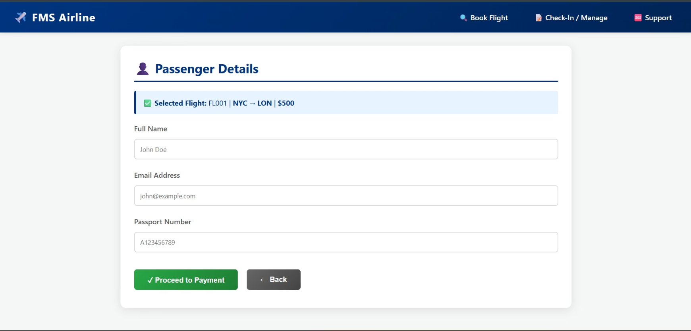



Frontend Architecture: SPA Design
A vanilla JavaScript Single-Page Application (SPA) provides the user interface, emphasizing a performant and lightweight experience without heavy frameworks.
Book Flight
Intuitive search and booking form.
Manage Booking
Retrieve and cancel existing bookings.
Check-In
Streamlined digital check-in process.
Support
Portal for tickets and inquiries.

Slide 6





Complete Booking Workflow
A step-by-step process from flight search to boarding.
Search Flights
Create Booking
Process Payment
Check-In

Slide 7
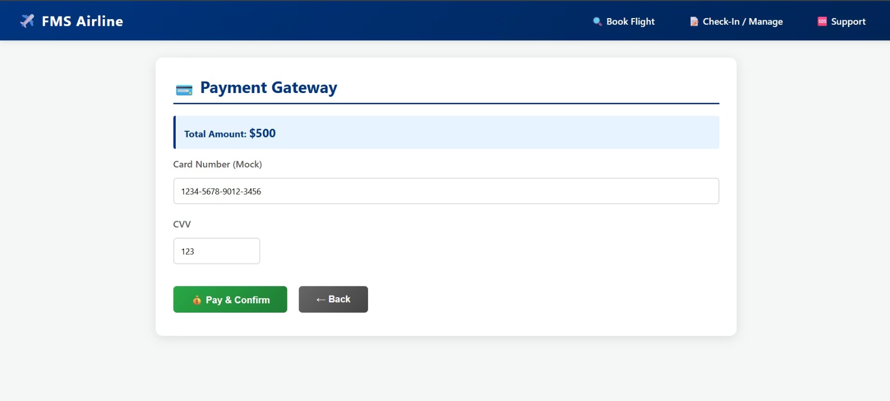
Payment Processing & Transaction Management
Secure payment processing with card details validation and transaction confirmation.
Mock Payment Gateway Integration
Simulates payment gateway for development and testing, ensuring robust system behavior.
Card Validation (basic length check)
Client-side validation of card number format and length for data integrity.
Status Update (PENDING_PAYMENT → CONFIRMED)
Transitions status from PENDING_PAYMENT to CONFIRMED post-authorization.
Ticket Issuance
Automates e-ticket generation and distribution after payment confirmation.

Slide 8
Security Considerations: Prototype Limitations
The prototype, designed for functional validation, possesses known vulnerabilities due to its simplified implementation approach.
Vulnerability
Risk Level
Production Fix
No Authentication
Critical
Implement JWT/OAuth 2.0
Plain Card Numbers
Critical
Payment tokenization
PNR Enumeration
Medium
Rate limiting + CAPTCHA
No Input Validation
Medium
Server-side validation library (e.g., Joi)
CORS Wide Open
Medium
Restrict CORS to authorized origins
No Rate Limiting
Medium
Implement robust API rate limiting

Slide 9
API Endpoints & Testing Strategy
API Endpoints Reference
Method
Endpoint
Description
GET
/api/flights
Search flights (Query: origin, destination, date)
POST
/api/booking
Create booking (Request: flightId, passengerName, email, passport)
POST
/api/payment
Process payment (Request: pnr, cardNumber)
POST
/api/checkin
Check in passenger (Request: pnr, passport)
POST
/api/support
Create support ticket (Request: pnr, issueType, details)
GET
/api/booking/:pnr
Get booking details (Path param: pnr)
POST
/api/cancel
Cancel booking (Request: pnr)
API Design Principles
RESTful Conventions
Resource-Oriented URLs
Standard HTTP methods for CRUD operations
Each endpoint represents a resource
Proper Status Codes
JSON Request/Response
200 (OK), 400 (Bad Request), 404 (Not Found), 403 (Forbidden)
Consistent data format across all endpoints
Testing & Validation Strategy
Unit Testing
Integration Testing
Test Cases
Controller endpoints, data models, algorithms
End-to-end workflow (search → booking → payment → check-in)
Search flights, create booking, process payment, check-in, cancel booking, support tickets
Validation Criteria
Production Testing
Correct HTTP status codes, proper error messages, data consistency, booking state transitions
Automated testing (Jest + Supertest), load testing, security testing (OWASP Top 10)

Slide 10
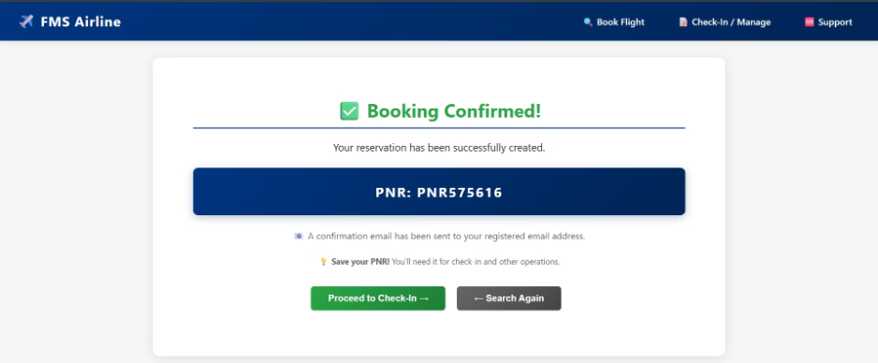
Booking Confirmation & Check-In Process
01
02
Successful Booking Confirmation
Boarding Pass Generation
A unique Passenger Name Record (PNR) is generated upon successful reservation, serving as the primary identifier for managing booking details and critical for subsequent travel stages.
Passengers receive a digital boarding pass with essential travel information, including confirmed seat assignment, departure gate, and precise boarding time.
03
Check-In Verification
Before boarding, a comprehensive check-in verification process ensures passenger security and regulatory compliance through passport matching and advanced identity checks.

Slide 11

Conclusion & Future Directions
This prototype successfully demonstrates the implementation of core airline reservation system architecture and development practices, laying a robust foundation for further academic and practical exploration.
Key Takeaways
Learning Outcomes
Three-tier MVC architecture for separation of concerns.
Understanding of complex flight booking domain logic (seat allocation, booking).
Well-defined data models for flights, passengers, and bookings.
Expertise in robust API design principles.
RESTful API conventions for efficient communication.
Development of effective state management strategies.
Security considerations through validation patterns.
Practical experience in integrating various system components.
Responsive Single-Page Application (SPA) design.
Implementation of comprehensive error handling mechanisms.
Production Next Steps
Integrate a persistent database layer for data integrity.
Implement a secure authentication and authorization system.
Integrate a real-time payment gateway.
Conduct comprehensive automated testing.
Establish CI/CD pipelines.
Strategize cloud deployment for reliability and availability.

